Slide 2
Django app, part 2
https://docs.djangoproject.com/en/3.0/intro/tutorial02/

Slide 3
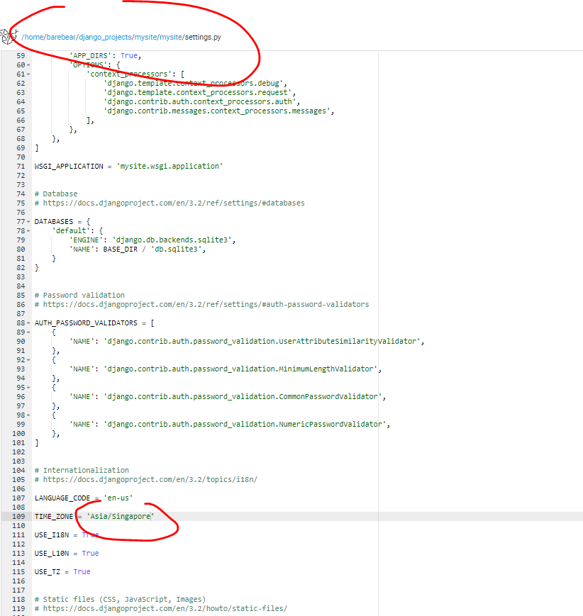
Change timezone
Barebear/Django_projects/mysite/mysie/settings.py

Slide 4
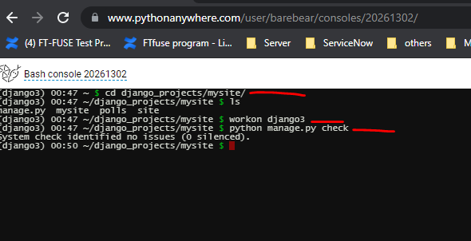
Check no error

Slide 5
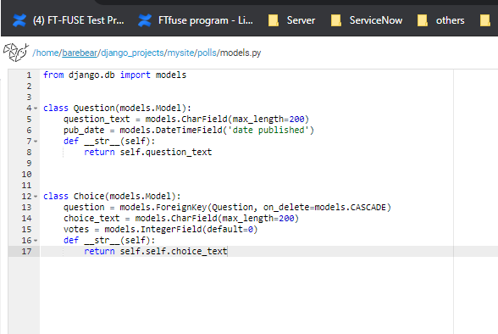
Define models
Models help to define database layout
Create 2 models “Question” and “Choice” in poll app
Each model is representend by a class which is subclasses of
Django.db.models.model
Notes:
Models help us to define database layout

Slide 6
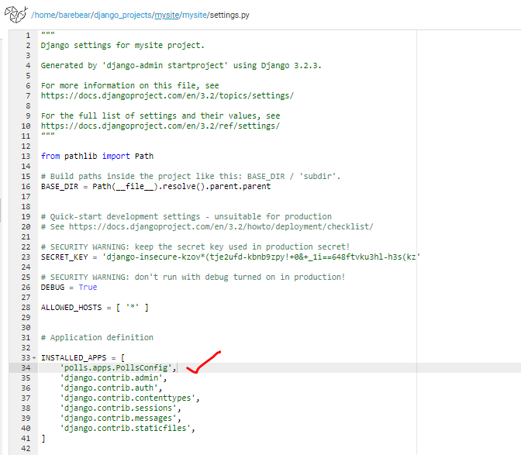
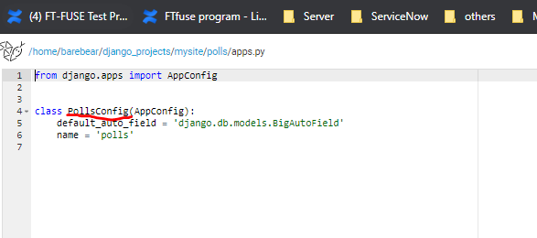
Include app in our peoject
Edit “mysite/settings.py” to include the new app reference
New app reference name can be found in the polls/apps.py

Slide 7
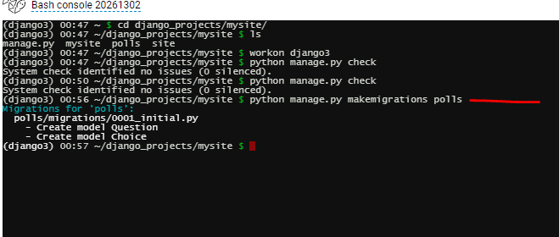
makemigrations
Notes:
By running makemigrations, you’re telling Django that you’ve made some changes to your models (in this case, you’ve made new ones) and that you’d like the changes to be stored as a migration.

Slide 8
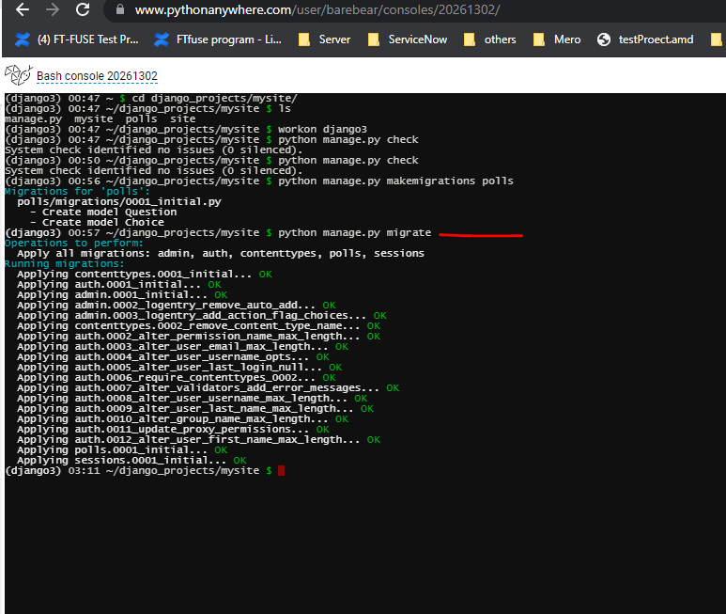
migrate

Slide 9
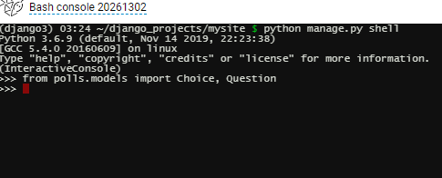
Put contents into the database question table
python manage.py shell
from polls.models import Choice, Question

Slide 10
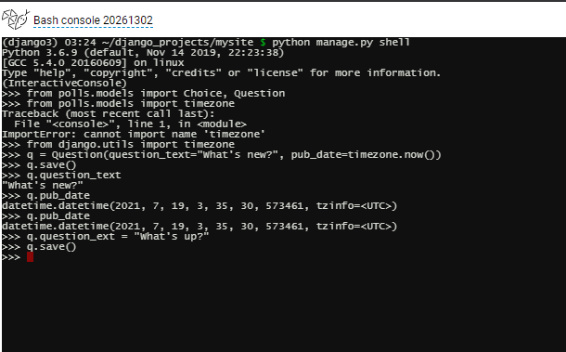
Continue….(create questions)
from django.utils import timezone
q = Question(question_test = “What’s new?”, pub_date=timezone.now())
q.save()
q.question_ext = “What’s up”
q.save()

Slide 11
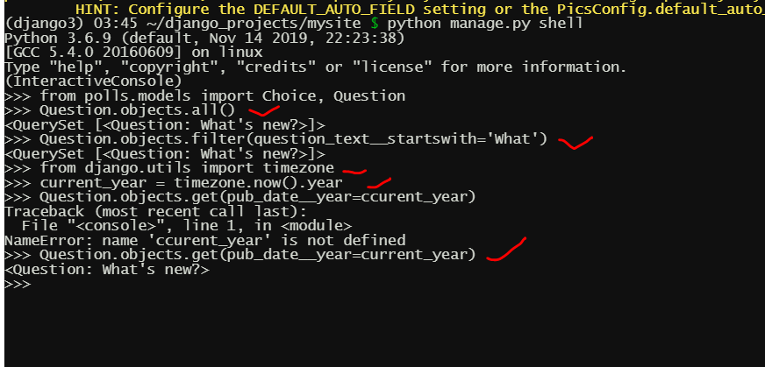
Continue..
Question.objects.all()
Question.objects.filter(question_text__startswith=‘what’)
current_year = timzone.now().year
Question.bojects.get(pub_date__year=current_year)

Slide 12
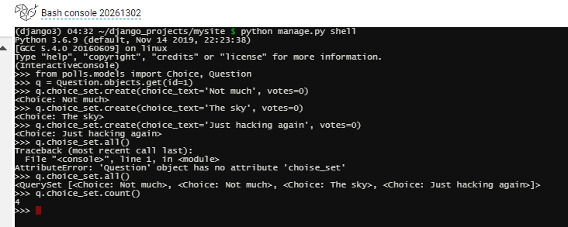
Put contents into the database option table
q=Question.objects.get(id=1)
q.choice_set.create(choice_text=“Not much”, votes=0)
q.choice_set.create(choice_text=“”The sky”, votes=0)
q.choice_set.create(choice_text=“”Just hacking again”, votes=0)
q.choice_set.all()
q.choice_set.count()

Slide 13
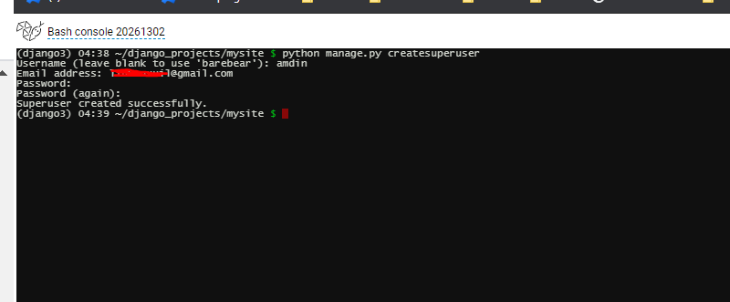
Django admin
python manage.py creatsuperuser
Username: admin
Notes:
Pw: ABC@barebear
Username: amdin(typo☹)

Slide 14
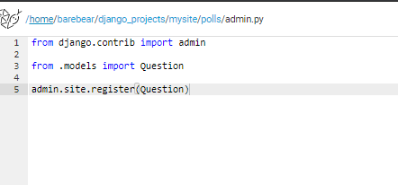
Edit polls/admin.py

Slide 15
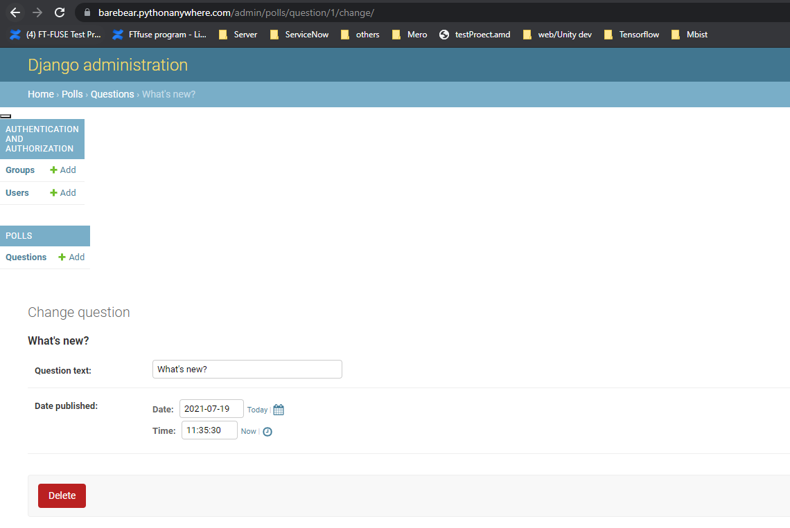
Login in to check result

